Slide 1
Load Balancing and Redundancy
Cloud Security Day 3
1

Slide 2


Class Objectives
By the end of today’s class, you will be able to:
Write an Ansible Playbook to configure VMs.
Create a load balancer on the Azure platform.
Create firewall and load balancer rules to allow traffic to the correct VMs.
2
Notes:
shutterstock_1214853796

Slide 3
Ansible Playbooks
3

Slide 4
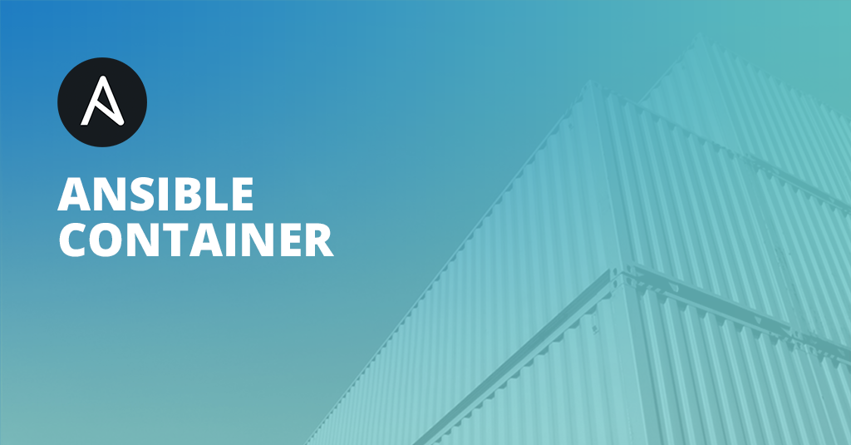
We have implemented a jump box that is running an Ansible container.
The Ansible container has full access to our VNet and can connect with our new VM. Now we will write code that will be “infrastructure as code” for this vulnerable web server.
(Ansible.com)
4

Slide 5

Ansible reads YAML code.
YAML stands for YAML ain’t markup language and is designed to be very readable and easy to write.
5

Slide 6

Today, we’ll get started with a walkthrough of YAML.
6
Notes:
shutterstock_1356969188

Slide 7
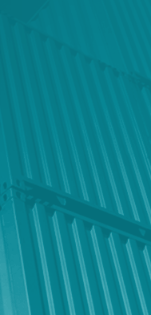
YAML
Today, we’ll get started with a walkthrough of YAML.
Ansible reads YAML code.
---
- name: My first playbook
hosts: webservers
become: true
tasks:
- name: Install apache httpd (state=present is optional)
apt:
name: apache2
state: present
7

Slide 8
YAML Walkthrough
8

Slide 9
Activity: Ansible Playbooks
In this activity, you will create an Ansible playbook that installs Docker and configures a VM with the DVWA web app.
20 Minutes
9

Slide 10
10

Slide 11
Load Balancing
11

Slide 12

So far, we created a virtual network, deployed a jump box running an Ansible Docker container, and used that container to configure another VM running a DVWA container.
12

Slide 13
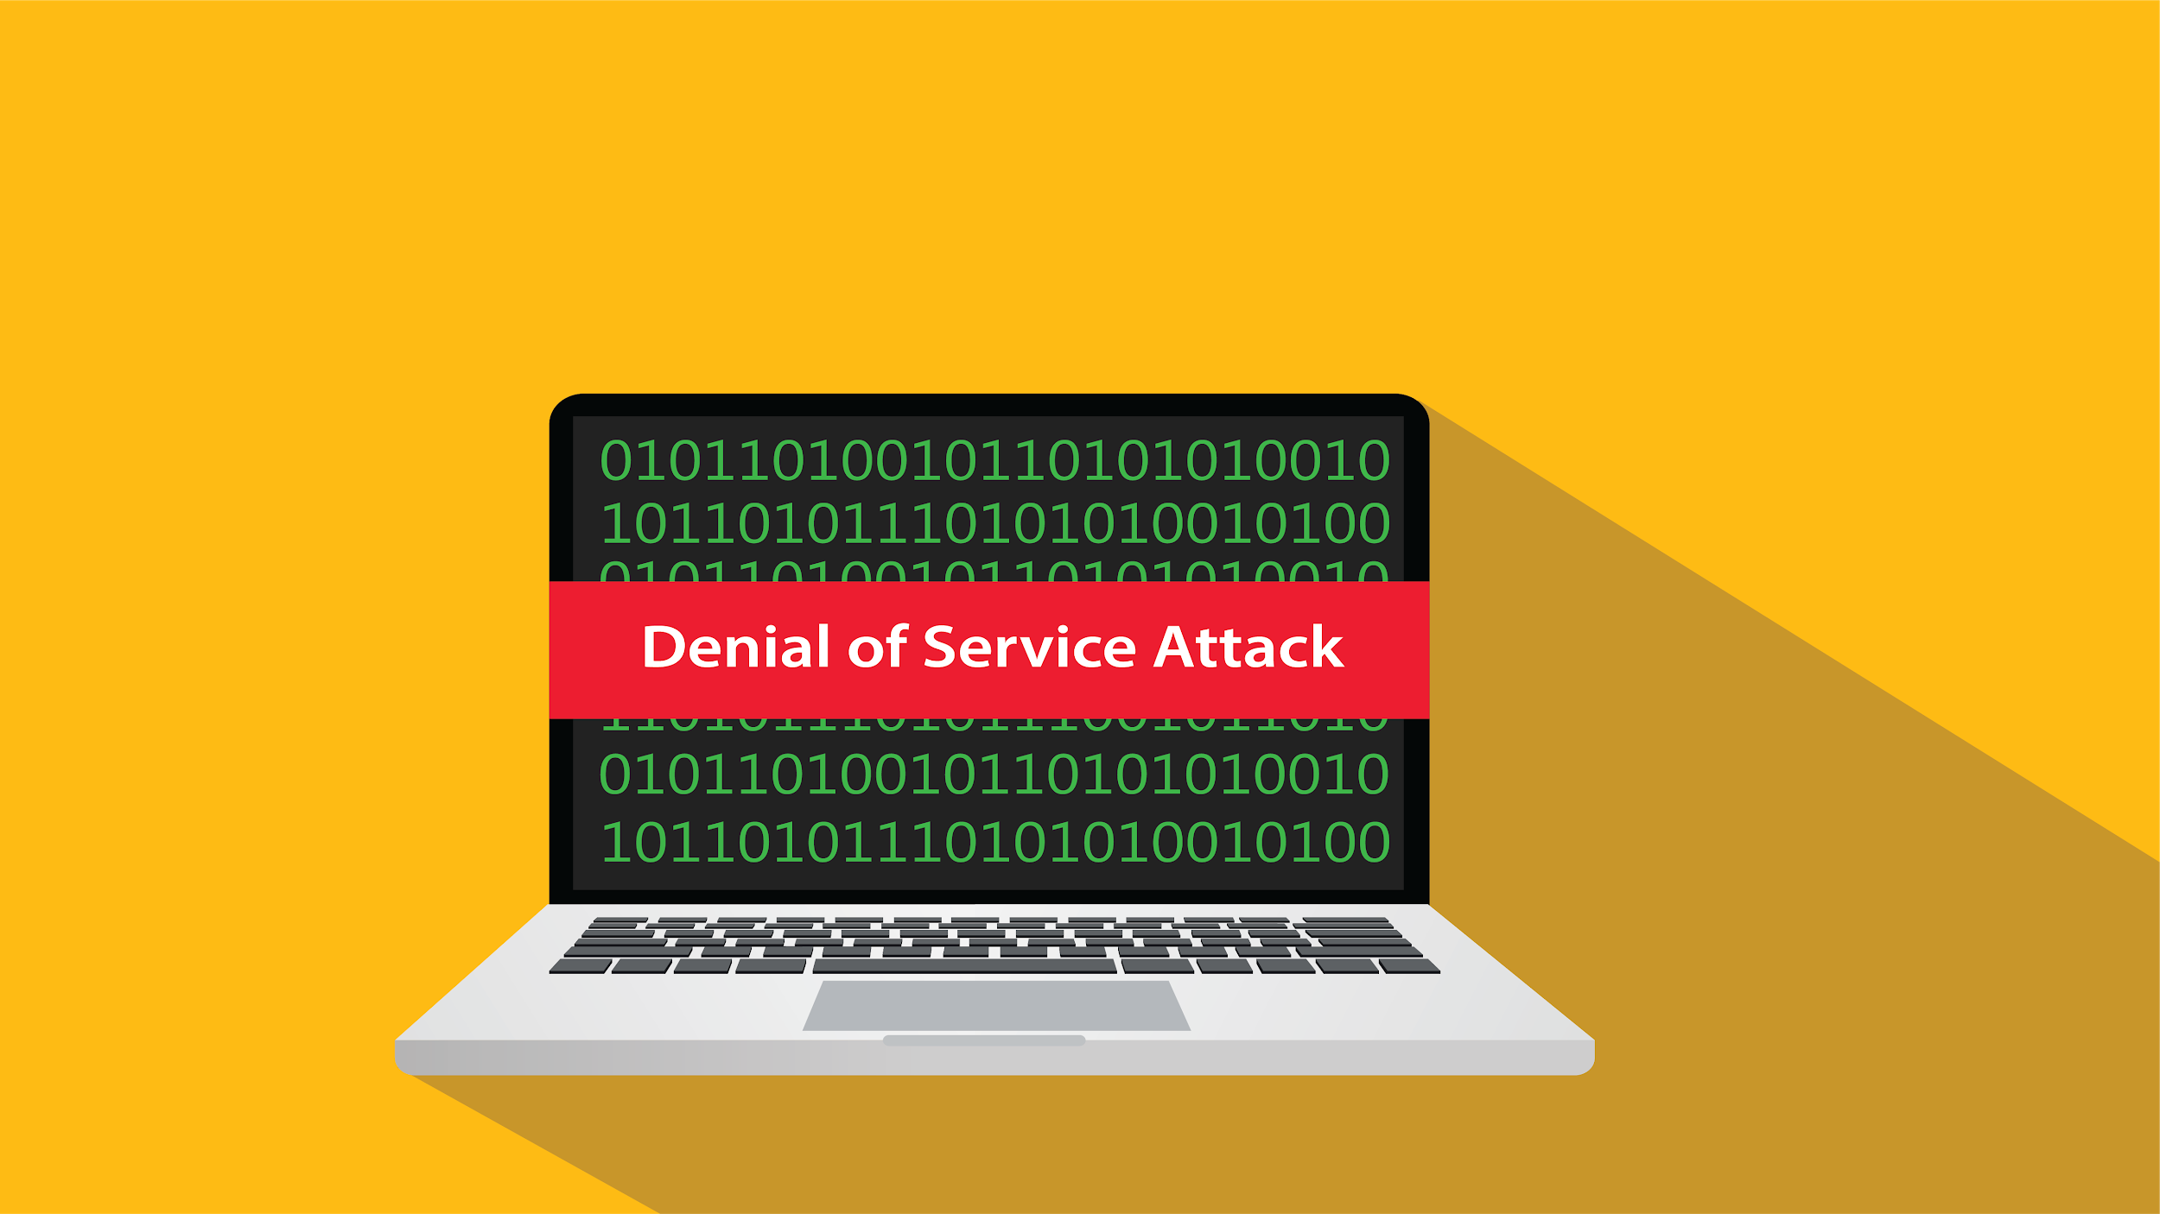
Load Balancing
If the Red Team attacks this DVWA container with enough traffic, they may be able to trigger a Denial of Service on the machine.
13
Notes:
shutterstock_599075135

Slide 14
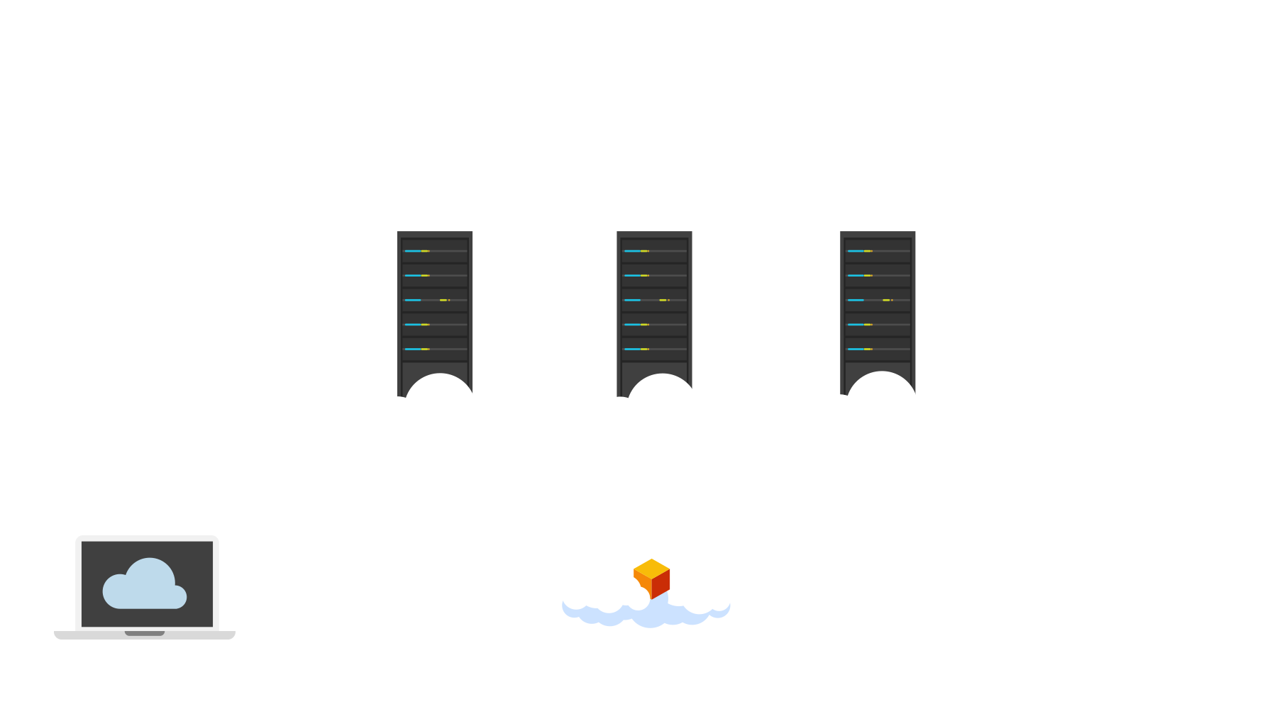
Load Balancers
A load balancer provides the external IP address that the rest of the internet can access. Then, it receives traffic that comes into the website and distributes it across multiple servers.
As websites receive more traffic, more servers can be added to the group (“pool”) of servers that the load balancer has access to.
This helps distribute traffic evenly across the servers and mitigates DoS attacks.
14
Notes:
Image source: shutterstock_1032652768

Slide 15
Load Balancers
Load balancers offer a health probe function to regularly check all the machines behind the load balancer. Machines with issues are reported, and the load balancers stop sending traffic to those machines.
✓
×
15
Notes:
Image source: shutterstock_1032652768

Slide 16
The DVWA VM we set up is not accessible from the internet at this time. This is intentional.
The next step is to set up a load balancer that has an external IP, and point it to the VM.
16

Slide 17
Activity: Load Balancing
In this activity, you will install a load balancer in front of the VM to distribute the traffic across more than one VM.
20 Minutes
17

Slide 18
18

Slide 19
Firewall Configuration
19

Slide 20
Now that we have a load balancer running, we want to make sure it is configured properly to allow traffic to the VM backend pool.
By the end of the next activity, we will be able to reach the DVWA website from the internet.
20

Slide 21

Firewall Configuration
We need to configure a security group to allow web traffic into the VNet from the load balancer.
In the following walkthrough, we’ll create a load balancing rule.
(Source)
21

Slide 22
Load Balancing Rule
22

Slide 23
Activity: Security Configuration
In this activity, you will configure the load balancer and security group to work together to expose port 80 of the VM to the internet.
20 Minutes
23

Slide 24
24

Slide 25
25

Slide 26
Redundancy
26

Slide 27
Next, we want to configure a new VM and place it behind our load balancer.
27

Slide 28
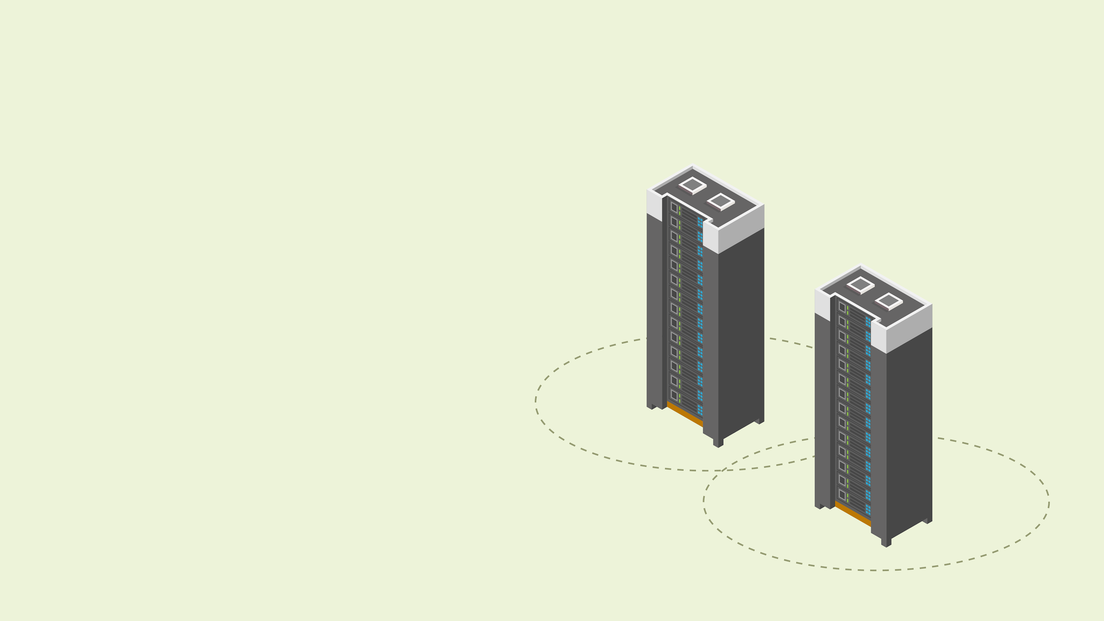

Redundancy
Placing another VM behind our load balancer provides redundancy for our DVWA server.
Multiple servers are often used in a setup like this. The more servers you use, the more resilient the website.
Setting up a second server will complete our highly available setup. If the Red Team takes down one server, the second will step in.
Many modern websites use this setup to stay up and running.
28
Notes:
shutterstock_792833623

Slide 29
Redundancy
You have all the knowledge to set up a redundant server for your next activity:
Get your SSH key from the Ansible container on your jump box.
Create a new VM using that key and the same admin name you used on the first VM.
Edit your Ansible configuration to include the new VM.
Use Ansible to configure the new VM with a DVWA container.
Place the new VM behind your load balancer.

Slide 30
Activity: Redundancy
In this task, you will create a copy of your VM using Ansible for the configuration and place it in the backend pool for your load balancer.
40 Minutes

Slide 32
Daily Checklist
By the end of today, you should have completed the following critical tasks:
An Ansible playbook has been created that configures Docker and downloads a container.
The Ansible playbook is able to be run on the Web VMs.
The Web VMs are running a DVWA Docker container.
A load balancer has been created and at least two Web VMs placed behind it.
The DVWA site is able to be accessed through the load balancer from the internet.

Slide 33

Don’t forget to power off your machine!

